Slide 1
Introduction to Programming

Slide 2
Chapter 7: Practical Computing for Biologists
Many elements are universal to all programming languages
Understanding these elements you will be more versatile at working across languages and will understand the common tools available to you.
Think about your data as a series of programmable tasks ‘pseudocode’

Slide 3
Baking a Pie
Series of small tasks
Could be written in any language
Think of steps as programmable tasks
The words are the terms of the programming language

Slide 4
Compiled vs. Interpretive Languages
Compiled
C, C+, Java
Translated from human readable code (source code) to computer understandable instructions – specific to each system
Only has to be compiled once
Interpreted (or scripting languages)
perl, python, ruby, R, Matlab
Processed by an interpreter each time they run – the interpreter is a compiled program
Has to be interpreted every time it is run
Program itself is the source code, easy to modify and can be run on any machine
BASH was our interpreter for the shell scripts you wrote

Slide 5
Now - basics of programming, a little vocab
Arguments – values that are sent to the program when it is run
Code -
Noun – a program or line of a program
Verb – the act of writing a program
Execute – to begin and carry out the operation of a program (run)
Function – a subprogram that can be called repeatedly to perform the same task
Parameters – Values that are sent to a function when it is called
Parse – To extract particular data elements from a larger block of text
Return – in a function – the act of sending back a value
Run - execute the sequence of commands in a program
Statement – a line of a program or script which can assign a value, do a comparison or perform other operations.

Slide 6
How to write a program – four questions
What do you want to do?
What variables do you want to make?
How are you going to move through it?
What do you want returned at the end?
One great way to write scripts is to first write
pseudocode

Slide 7
Basic Building Blocks of Programs
Variables
Flow Control
Lists and Dictionaries
Input and Output

Slide 8
Variable
A name that holds a value
Can be a number, character or series of characters or more complex (lists)
Attributes
Name – plain word that indicates its contents
$filename, $filelist – sometimes need the $ (perl, BASH) not python
Type – kind of information the variable contains
Value – actual piece of information it holds

Slide 9
Variable Types
Integer – whole numbers no fractional component = 123
Floating point – decimal can float to any position
not just at the end = 12.3
Boolean – have one of two values (True or False)
String – sequence of text characters = “This is a string”

Slide 10
Variables as Containers - arrays and lists
Array – collection of data that lives under one variable name
One dimensional array is called a list or a vector
Can be a single type or multiple types
my_list = [‘6’,’apple’,’13.5’]
Each item in the array can be referred to by its position in the list (ordered), first element is zero
What would we get from this? my_list[1]
Two dimensionals refer to the column and row
my_big_list[2,3]

Slide 11
Variables as Containers - dictionaries
Dictionary called an associative array, hash or map
Another type of container for more than one variable
Collection of names (or keys) and associated values
Keys must be unique and any type of data
Fruit_dict= {}
Fruit_dict[‘apple’]=6
Fruit_dict[‘banana’]=3
Unordered, ask for values according to their keys NOT positional arguments like arrays
What do we get from this? Fruit_dict[‘banana’]
Notes:
Show the translate.pl script – how I wrote code to translate DNA into Amino Acid.

Slide 12
Variables in Action
Mathematical operators
+ * /
variable1 + variable2
Both integers – get the sum
Both strings - concatenate them
Comparative – compare two things and return a Boolean (TRUE FALSE)
== > in
Logical
and or not
Functions – little stand alone program called from within the script
Given parameters and return things.
y=round(2.718)

Slide 13
Variables in Action
Mathematical operators
+ * /
variable1 + variable2
Both integers – get the sum
Both strings - concatenate them
Comparative – compare two things and return a Boolean (TRUE FALSE)
== > in
Logical
and or not
Functions – little stand alone program called from within the script
Given parameters and return things.
y=round(2.718)
parameter
return
function

Slide 14
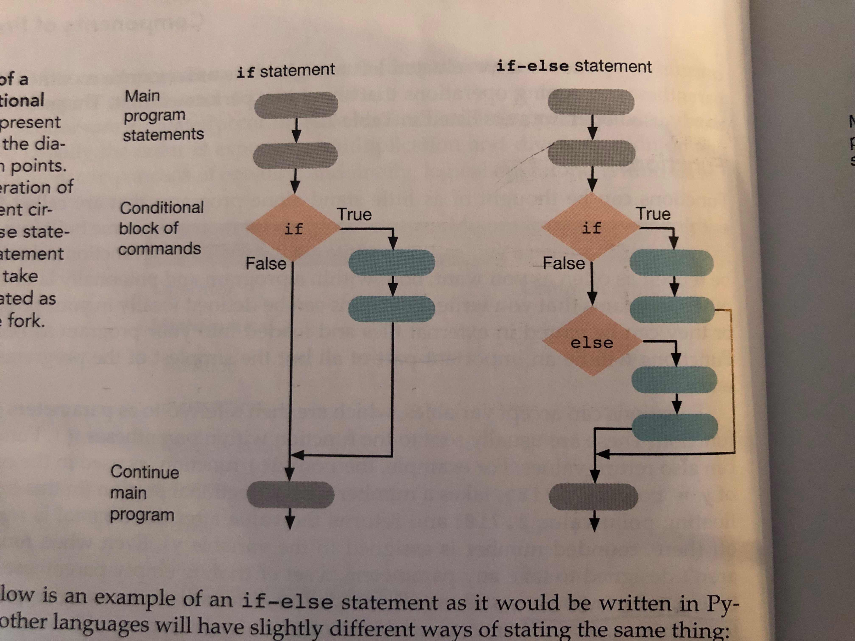
Flow Control - if
if statement –
Most widely used building block – think of it as a decision, a fork in the road.
Evaluates an if statement and returns a Boolean – if TRUE – then executes a series of commands.
Notes:
Range of numbers, species names
Can be nested

Slide 15
Flow Control – if/else
if statement –
Most widely used building block – think of it as a decision, a fork in the road.
Evaluates an if statement and returns a Boolean – if TRUE – then executes a series of commands.
else statement –
combined with if to execute a series of commands.
Notes:
Range of numbers, species names
Can be nested

Slide 16
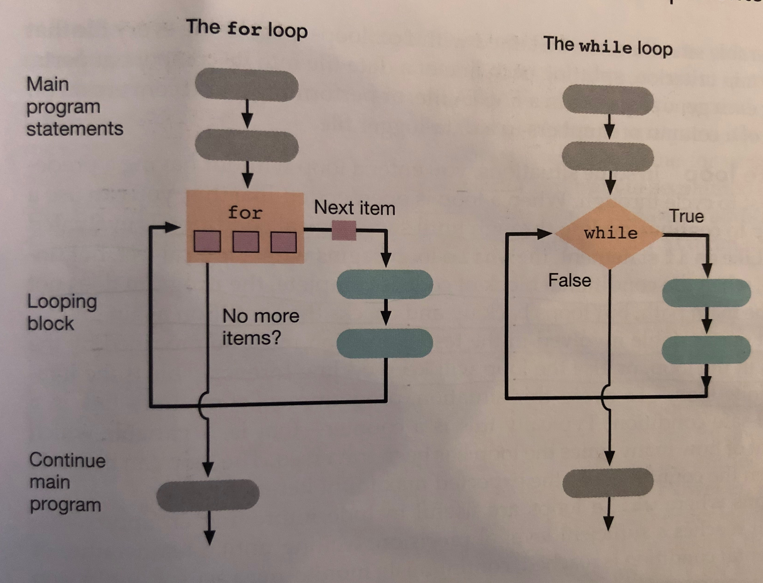
Flow Control - loops
Loops are portions of programs that are executed until some condition is met
for loop – cycles through each item of a predefined collection
while loop without a predetermined list – just until a condition is met
Notes:
Range of numbers, species names
Can be nested

Slide 17
How to write a program – four questions
What do you want to do?
What variables do you want to make?
How are you going to move through it?
What do you want returned at the end?

Slide 18
Pseudocode – one of your best friends
This is on your homework
Write out in words the building blocks of a program.
If you write out your pseudocode first you will save a gazillion hours of time.

Slide 19
Lets start Jupyter Notebooks

